Slide 1
Rajalakshmi Engineering College
An Autonomous Institution
Chennai-602105

Slide 2

PRINCIPLES OF ARTIFICIAL INTELLIGENCE (AI19341)

Slide 3

SYLLABUS
UNIT-II Search techniques
Problem solving agents, searching for solutions; uniform search strategies: breadth first search, depth first search, depth limited search, bidirectional search, comparing uniform search strategies. Heuristic search strategies Greedy best-first search, A* search, AO* search, memory bounded heuristic search: local search algorithms & optimization problems: Hill climbing search, simulated annealing search, local beam search.

Slide 4
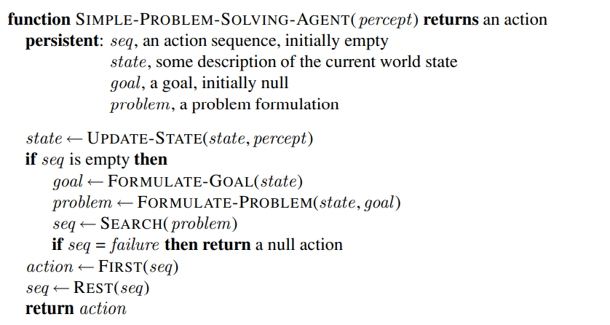
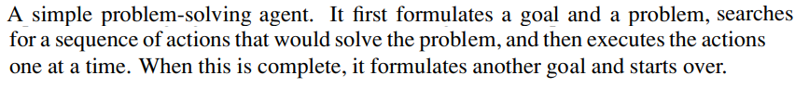
Problem Solving Agent

Slide 5
Problem Solving Agent-Approach
Goal Formulation-
Goal={world states which achieves desired results}
Goals help to organize behavior by limiting the objectives.
Problem Formulation-
After setting the goals ,it is the time to find out what will be the sequence of action which generate goal set.
It is the process of deciding what actions and states to consider , given a goal.
Searching-The agent’s search for desirable sequence of actions.
Execution- Once a solution is found , the actions it recommends can be carried out in the execution phase.

Slide 6
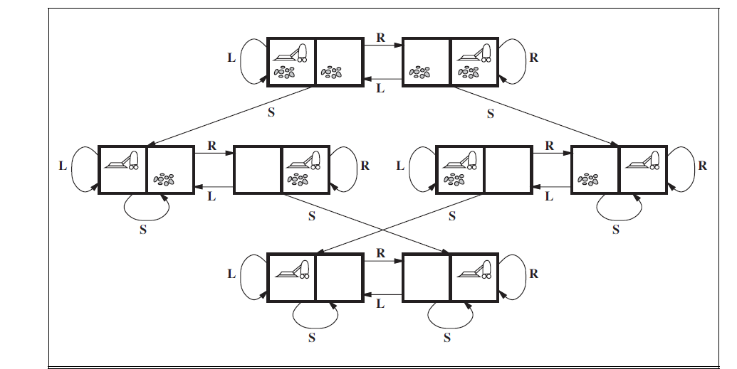
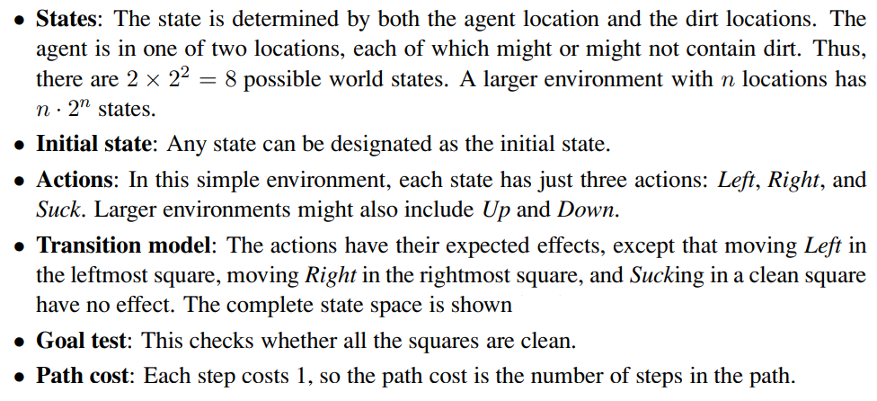
Toy problems - Vacuum world

Slide 7
Uninformed Search Strategies
Also called blind search
The strategies have no additional information about states beyond that provided in the problem definition.
All they can do is generate successors and distinguish a goal state from a non-goal state.

Slide 8
Uninformed Search Strategies
The search strategies are distinguished by the order in which nodes are expanded into:
Breadth First Search
Uniform Cost Search
Depth First Search
Depth Limited Search
Iterative Deepening Search
Bidirectional Search

Slide 9
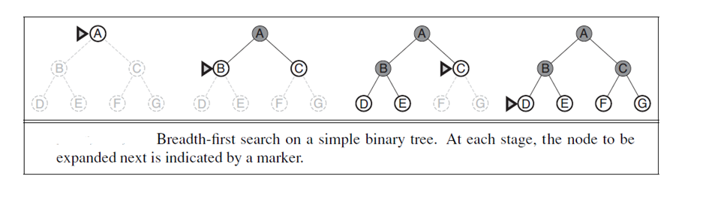
Breadth First Search (BFS)
Simple strategy in which the root node is expanded first, then all the successors of the root node are expanded next, then their successors, and so on.
All the nodes are expanded at a given depth in the search tree before any nodes at the next level are expanded.
The shallowest unexpanded node is chosen for expansion.
This is achieved very simply by using a FIFO queue.
Goal test is applied to each node when it is generated.

Slide 10
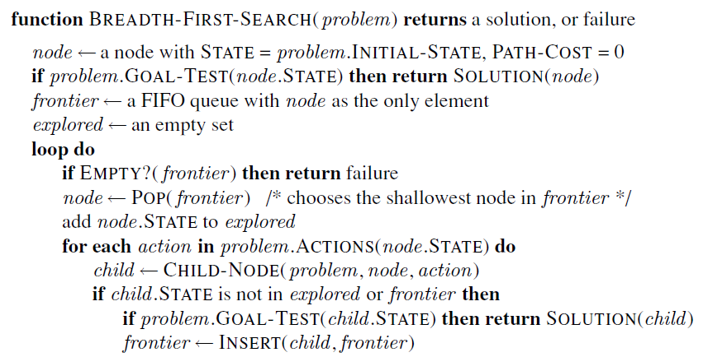
Breadth First Search (BFS)

Slide 11
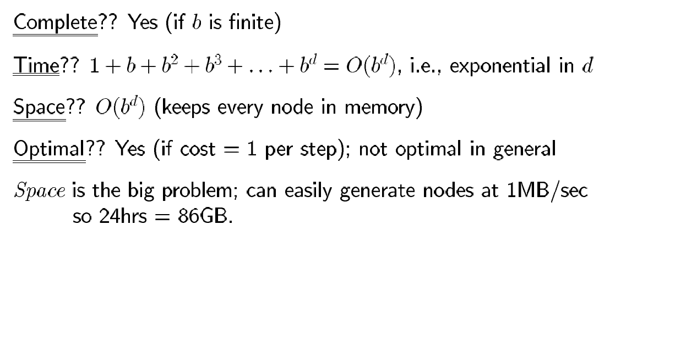
Properties of BFS
Path(step) cost is always 1 for each step.

Slide 12
BFS-Example(To find a route from S-G)
The path in the 2nd depth level that is SBG (or ) SCG.

Slide 13
Uniform Cost Search (UCS)
Expands the node n with the lowest path cost g(n).
This is done by storing the frontier as a priority queue ordered by the path cost g.
The first is that the goal test is applied to a node when it is selected for expansion.
Uniform-cost search does not care about the number of steps a path has, but only about their total cost.
If all step costs are equal ,this is identical to the BFS.
It will get stuck in an infinite loop , if it ever expands a node that has a zero –cost action leading to the same state.

Slide 14
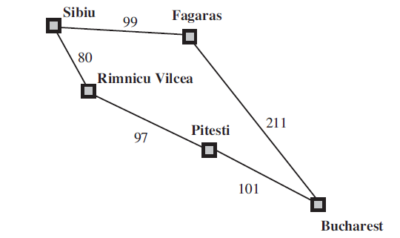
Uniform Cost Search (UCS) Find path from Sibiu to Bucharest
Least cost node (in order)=[R, F]
S-R = 80 and S-F = 99
Expand least cost node R first.
80 + 97(R-P) = 177 Now F is the only least cost node (since 99<177 expand it).
99 + 211(F-B) = 310 (reached the goal node, still the search goes on since 177<310)
177 + 101(P-B) = 278
Now, we have 2 solutions/paths to reach B (1. S-R-P-B (278) 2.S-F-B (310))
Solution 1 has the lowest path cost and hence it will be returned by the algorithm.

Slide 15
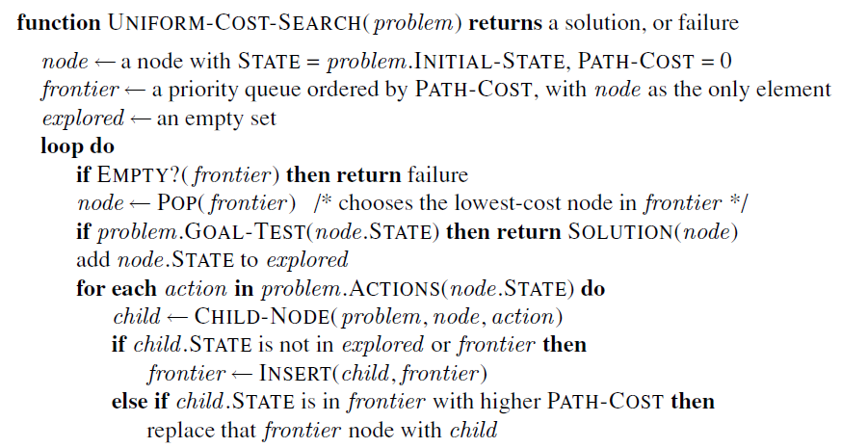
Uniform Cost Search (UCS)

Slide 16
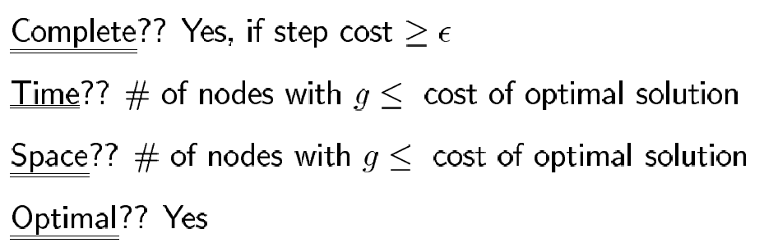
Properties of UCS
O(b^{1+C∗/∊})

Slide 17
Depth First Search (DFS)
Expands the deepest node in the current frontier of the search tree.
Depth-first search uses a LIFO queue (stack).
It has modest memory requirement.
It needs to store only a single path from the root to a leaf node, along with remaining unexpanded sibling nodes for each node on a path
Back track uses less memory.

Slide 18
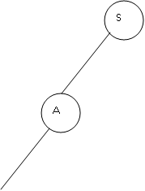
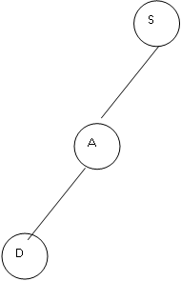
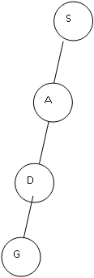
DFS- Example (To find a route from S-G)

Slide 19
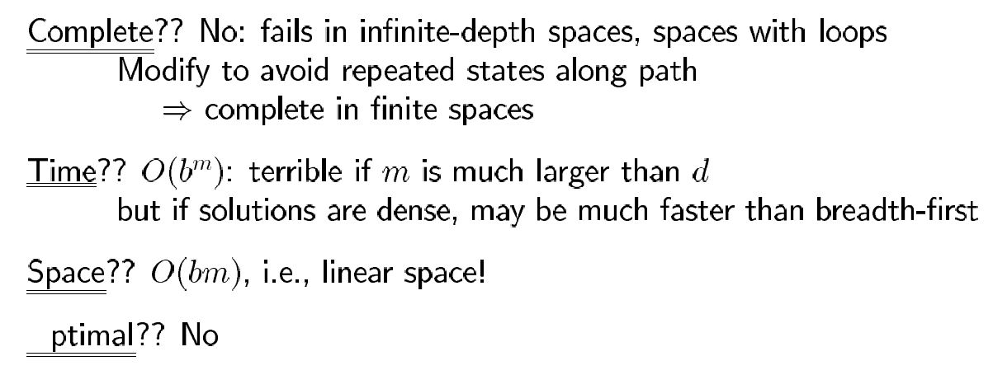
Properties of DFS

Slide 20
Depth Limited Search (DLS)
A cut off (Maximum level of the depth) is introduced in this search technique to overcome the disadvantage of Depth First Search.
The cut off value depends on the number of states.
DLS can be implemented as a simple modification to the general tree search algorithm or the recursive DFS algorithm.
DLS imposes a fixed depth limit on a DFS.
A variation of depth-first search that uses a depth limit
Nodes at depth are treated as if they have no successors.
Unfortunately, it also introduces an additional source of incompleteness if we choose l < d, that is, the shallowest goal is beyond the depth limit.
Depth limits can be based on knowledge of the problem.

Slide 21
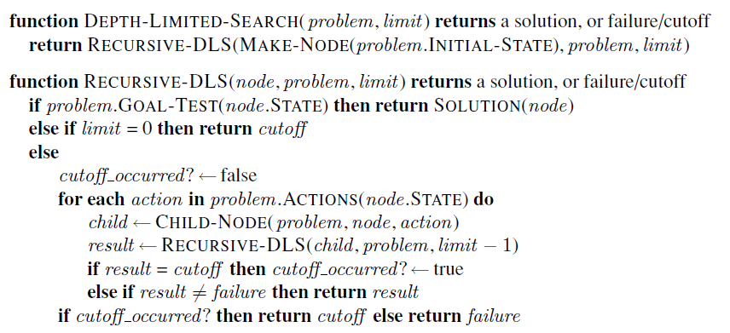
Depth Limited Search (DLS)

Slide 22
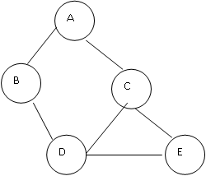
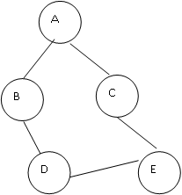

DLS-Example ( Find a path from A-E)
The number of states in the given map is five. So, it is possible to get the goal state at the maximum depth of four. Therefore, the cut off value is four.
A
B
C
The solution is A-B-D-E.

Slide 23
Properties of DLS
Time Complexity : O(b^{l})
Space Complexity: O(bl)
DFS is a special case of DLS where the l=ꝏ

Slide 24
Iterative Deepening DFS (IDS)
Combination of depth-first tree search, that finds the best depth limit.
It does this by gradually increasing the limit—first 0, then 1, then 2, and so on—until a goal is found.
This will occur until the depth limit reaches d, the depth of the shallowest goal node.

Slide 25
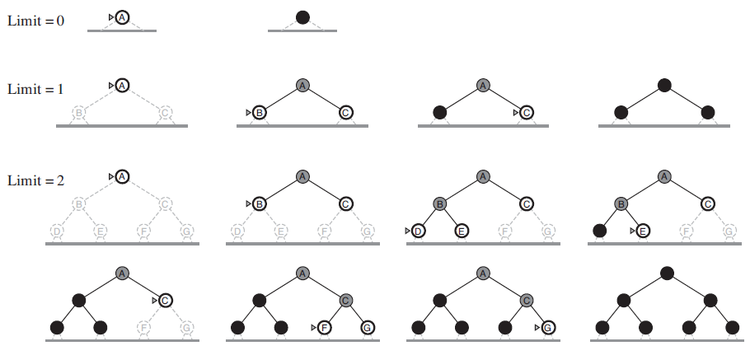
Iterative Deepening DFS (IDS)

Slide 26
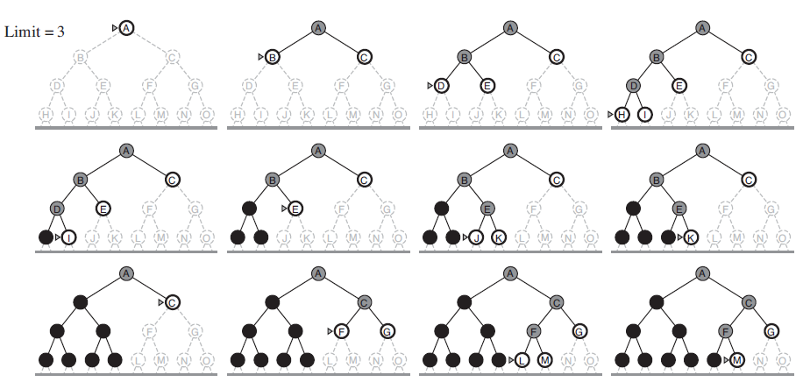
Iterative Deepening DFS (IDS)

Slide 27
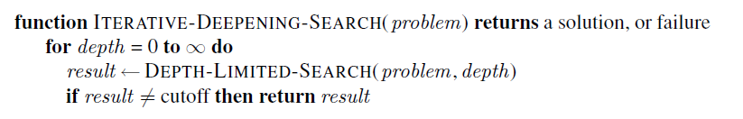
Iterative Deepening DFS (IDS)

Slide 28
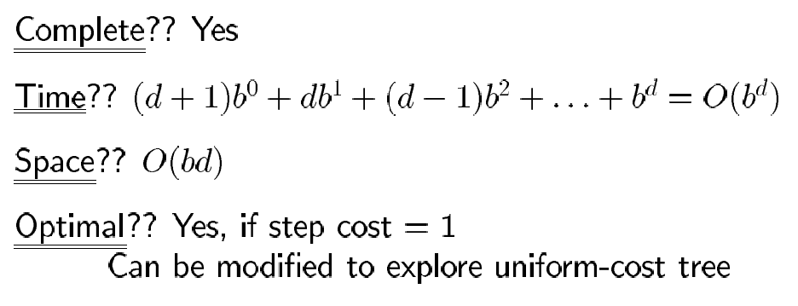
Properties of IDS

Slide 29
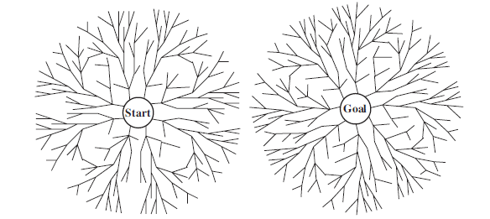
Bidirectional search
Run two simultaneous searches—one forward from the initial state and the other backward from the goal—hoping that the two searches meet in the middle.
Instead of Goal Test, if the two searches meet, return a solution.
Time and Space complexity : O(b^{d/2})

Slide 30
Bidirectional search

Slide 31
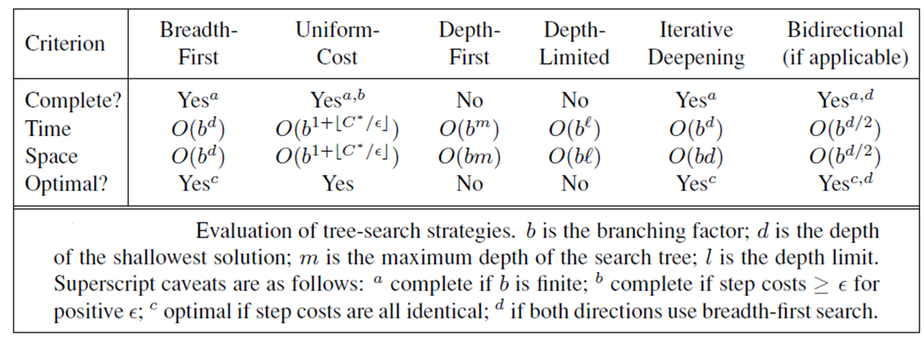
Comparing Uninformed Search Strategies

Slide 32
INFORMED (HEURISTIC) SEARCH STRATEGIES
Informed search strategy—one that uses problem-specific knowledge beyond the definition of the problem itself
Can find solutions more efficiently than search strategies that do not use domain specific knowledge.
find solutions even when there is limited time available

Slide 33
Best-first search
Best-first search is an instance of the general TREE-SEARCH or GRAPH-SEARCH algorithm in which a node is selected for expansion based on an evaluation function, f(n).
The evaluation function is construed as a cost estimate, so the node with the lowest evaluation is expanded first.
The implementation of best-first graph search is identical to that for uniform-cost search, except for the use of f instead of g to order the priority queue.
Most best-first algorithms include as a component of f a heuristic function, denoted h(n):
h(n) = estimated cost of the cheapest path from the state at node n to a goal state.
Heuristic functions are the most common form in which additional knowledge of the problem is imparted to the search algorithm.

Slide 34
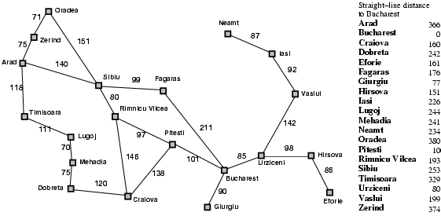

Romania with straight-line dist.
Heuristic Information

Slide 35
Greedy best-first search
f(n) = evaluation function = h(n)= estimate of cost from n to goal
e.g., f_{SLD}(n) = straight-line distance from n to Bucharest
Greedy best-first search expands the node that appears to be closest to goal.

Slide 36

Greedy best-first search example

Slide 37

Greedy best-first search example

Slide 38

Greedy best-first search example

Slide 39


Greedy best-first search example
Path cost = 140 +99+ 211 = 450
Alternate Solution:
140 +80+97 +101= 418

Slide 40
Properties of greedy best-first search
Complete? No – can get stuck in loops.
Time? O(b^{m}), but a good heuristic can give dramatic improvement
Space? O(b^{m}) - keeps all nodes in memory
Optimal? No
e.g. Arad→Sibiu→Rimnicu Virea→Pitesti→Bucharest is shorter!

Slide 41
A* search
The most widely known form of best-first search is called A∗ search
It evaluates nodes by combining g(n), the path cost to reach the node, and h(n), the cheapest cost to get from the node to the goal.
f(n) = g(n) + h(n) .
f(n) = estimated cost of the cheapest solution through n .
A∗ search is both complete and optimal.
Best First search has f(n)=h(n)

Slide 42

A* search example

Slide 43

A* search example

Slide 44

A* search example

Slide 45

A* search example

Slide 46

A* search example

Slide 47

A* search example

Slide 48
Admissible heuristics
A heuristic h(n) is admissible if for every node n, h(n) ≤ h*(n), where h*(n) is the true cost to reach the goal state from n.
An admissible heuristic never overestimates the cost to reach the goal, i.e., it is optimistic.
Admissible heuristics are by nature optimistic because they think the cost of solving the problem is less than it actually is.
Example: h_{SLD}(n) (never overestimates the actual road distance)
Theorem: If h(n) is admissible, A* using TREE-SEARCH is optimal

Slide 49
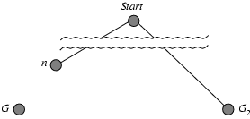
Optimality of A* (proof)
The tree-search version of A∗ is optimal if h(n) is admissible, Suppose some suboptimal goal G₂ has been generated and is in the fringe. Let n be an unexpanded node in the fringe such that n is on a shortest path to an optimal goal G.
f(G₂) = g(G₂) since h(G₂) = 0
f(G) = g(G) since h(G) = 0
g(G₂) > g(G) since G₂ is suboptimal
f(G₂) > f(G) from above
We want to prove:
f(n) < f(G2)
(then A* will prefer n over G2)

Slide 50
Optimality of A* (proof)
Suppose some suboptimal goal G₂ has been generated and is in the fringe. Let n be an unexpanded node in the fringe such that n is on a shortest path to an optimal goal G.
f(G₂) > f(G) copied from last slide
h(n) ≤ h*(n) since h is admissible (under-estimate)
g(n) + h(n) ≤ g(n) + h*(n) from above
f(n) ≤ f(G) since g(n)+h(n)=f(n) & g(n)+h*(n)=f(G)
f(n) < f(G2) from top line.
Hence: n is preferred over G2

Slide 51
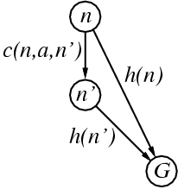
Consistent Heuristics
If h(n) is consistent, then the values of f(n) along any path are nondecreasing.
A heuristic is consistent if for every node n, every successor n' of n generated by any action a, h(n) ≤ c(n ,a , n') + h(n')
If h is consistent, we have
f(n') = g(n') + h(n')
= g(n) + c(n ,a , n') + h(n')
≥ g(n) + h(n) = f(n)
f(n’) ≥ f(n)
i.e., f(n) is non-decreasing along any path.
Theorem:
If h(n) is consistent, A* using GRAPH-SEARCH is optimal
It’s the triangle
inequality !
keeps all checked nodes in memory to avoid repeated states

Slide 52
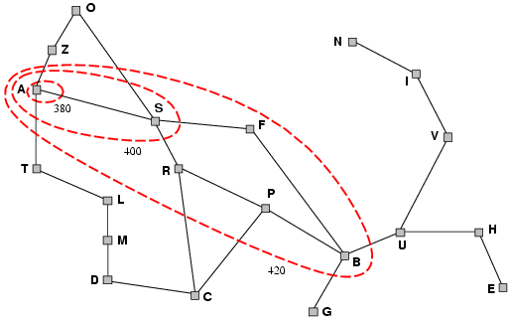
Optimality of A*
A* expands nodes in order of increasing f value
Gradually adds "f-contours" of nodes
Contour i contains all nodes with f≤f_{i} where f_{i} < f_{i+1}

Slide 53
Properties of A*
Complete? Yes (unless there are infinitely many nodes with f ≤ f(G) , i.e. path-cost > ε)
Time/Space? Exponential , in the maximum absolute error
When the state space has many goal states—particularly near-optimal goal states—the search process can be led astray from the optimal path and there is an extra cost proportional to the number of goals whose cost is within a factor ϵ of the optimal cost. Finally, in the general case of a graph, the situation is even worse. There can be exponentially many states with f(n) < C∗ even if the absolute error is bounded by a constant.
Optimal? Yes
Optimally Efficient: Yes (no algorithm with the same heuristic is guaranteed to expand fewer nodes)

Slide 54
Memory Bounded Heuristic Search: Recursive BFS
How can we solve the memory problem for A* search?
Idea: Try something like depth first search, but let’s not forget everything about the branches we have partially explored.
We remember the best f-value we have found so far in the branch we are deleting.

Slide 55
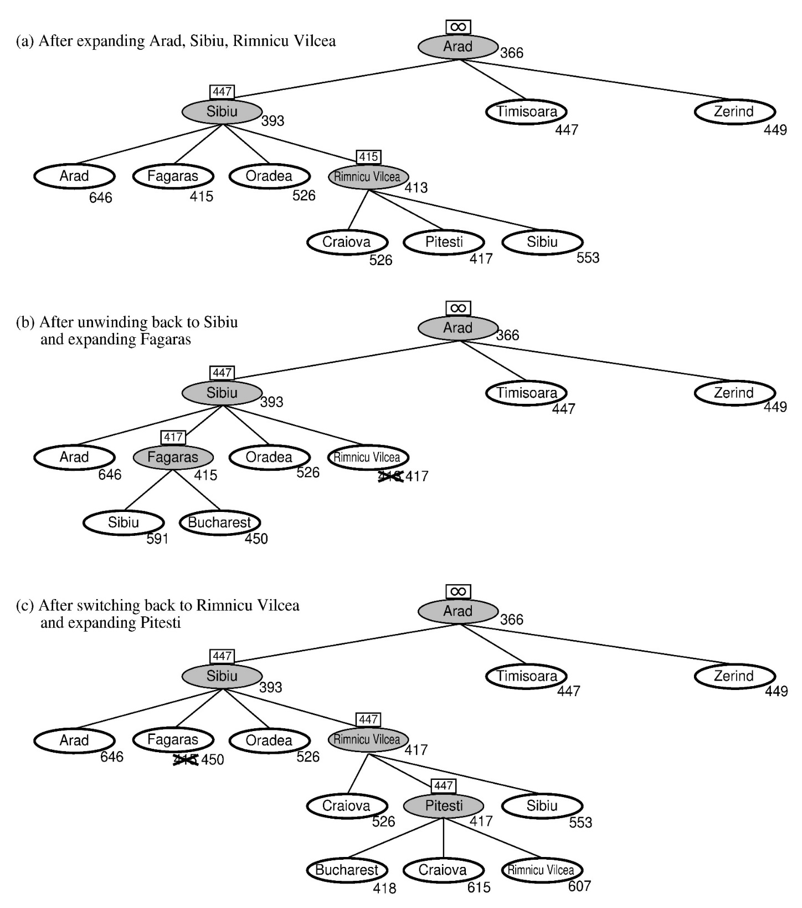
RBFS:
best alternative
over fringe nodes,
which are not children:
do I want to back up?
RBFS changes its mind very often in practice.
This is because the f=g+h become more accurate (less optimistic) as we approach the goal.
Hence, higher level nodes have smaller f-values and will be explored first.
Problem: We should keep
in memory whatever we can.

Slide 56
Simple Memory Bounded A*
This is like A*, but when memory is full we delete the worst node (largest f-value).
Like RBFS, we remember the best descendent in the branch we delete.
If there is a tie (equal f-values) we first delete the oldest nodes first.
simple-MBA* finds the optimal reachable solution given the memory constraint.
Time can still be exponential.

Slide 57

Admissible heuristics
E.g., for the 8-puzzle:
h₁(n) = number of misplaced tiles
h₂(n) = total Manhattan distance
(i.e., no. of squares from desired location of each tile)
h₁(S) = ? 8
h₂(S) = ? 3+1+2+2+2+3+3+2 = 18

Slide 58
Dominance
If h₂(n) ≥ h₁(n) for all n (both admissible)
then h₂ dominates h₁
h₂ is better for search: it is guaranteed to expand
less nodes.
Typical search costs (average number of nodes expanded):

Slide 59
Relaxed problems
A problem with fewer restrictions on the actions is called a relaxed problem
The cost of an optimal solution to a relaxed problem is an admissible heuristic for the original problem
If the rules of the 8-puzzle are relaxed so that a tile can move anywhere, then h₁(n) gives the shortest solution
If the rules are relaxed so that a tile can move to any adjacent square, then h₂(n) gives the shortest solution

